Slide 1

Credit Card Clients Dataset
Vishruth Acharya
Martin Aguirre
Yuvaraja Reddy Ambati
Varun Namala
Prasanth Chowdary Yanamandala
Group 2
Members:
Martin Aguirre
Vishruth Acharya
Yuvaraja Reddy Ambati
Varun Namala
Prasanth Chowdary Yanamandala

Slide 2
Dataset link: https://www.kaggle.com/datasets/uciml/default-of-credit-card-clients-dataset
Business Objective:
We aim to utilize logistic regression to train a model able to classify if a credit card client will default on their payments based on the independent variables provided (demographic factors, credit data, history of payment, etc.). This dataset contains information on default payments, demographic factors, credit data, history of payment, and bill statements of credit card clients in Taiwan from April 2005 to September 2005. We will use this model to predict if the client will default on payment of the credit card bill for the following month.
For feature selection, we have filtered some features on the basis of a few statistical techniques like step function, removing features that were correlated.
For null values, if any, we replaced them with the mean value of that column for numerical columns
and “new” value for categorical columns.
For outliers if any, we clipped them with lower capping of 0.1 and upper capping of 0.99.
We also transformed all the categorical columns into dummy columns i.e converted them to numerical
columns to get better results.

Slide 3
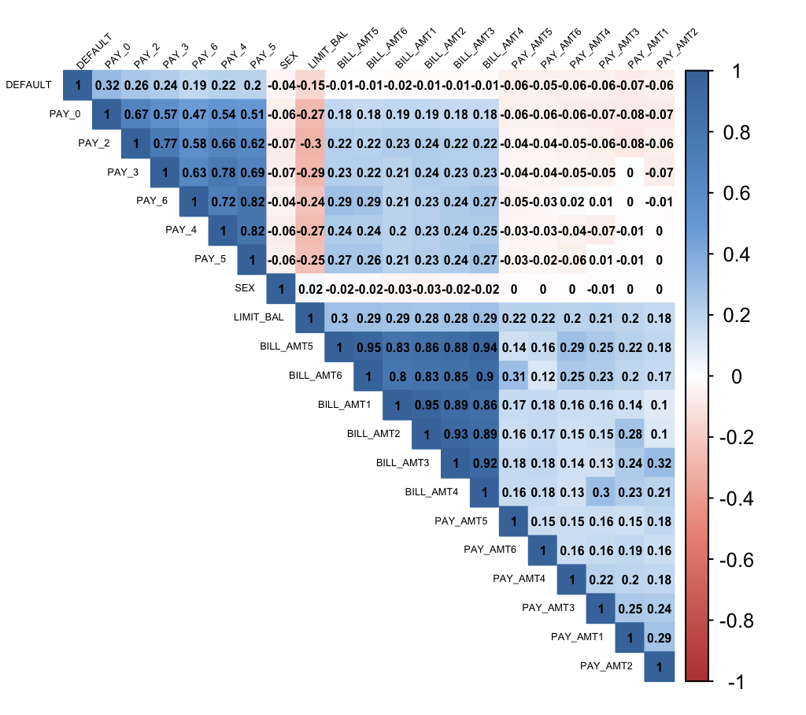
#Changing column name of the dependent variable and changing its data type.
colnames(df)[colnames((df)) == "default.payment.next.month"] = "DEFAULT"
df$DEFAULT = as.numeric(df$DEFAULT)
#Plotting Correlation Matrix
r = cor(df[-c(3, 4, 5, 26, 27)], method = 'pearson')
col_gd <- colorRampPalette(c("#BB4444", "#EE9988", "#FFFFFF", "#77AADD", "#4477AA"))
corrplot(r, method = "color", col = col_gd(200),
type = "upper", order = "hclust",
addCoef.col = "Black",
tl.col = "black", tl.srt = 45, number.cex = 0.5,tl.cex = 0.4)
The dark blue shade denotes strong positive association between variables and dark red shade denotes strong negative association between variables.

Slide 4
#Changing column types to factors so that algorithm does not take our nominal values as ordinal values.
df$SEX<- as.factor(df$SEX)
df$EDUCATION<- as.factor(df$EDUCATION)
df$MARRIAGE <- as.factor(df$MARRIAGE)
#Scaling all independent variables.
df[-c(24)] <- df[-c(24)]%>%
mutate(across(where(is.numeric), scale))
df$DEFAULT <- as.factor(df$DEFAULT)
df$PAY_0 = as.factor(df$PAY_0)
df$GENDER = ifelse(df$SEX == 1, "Male", "Female")

Slide 5
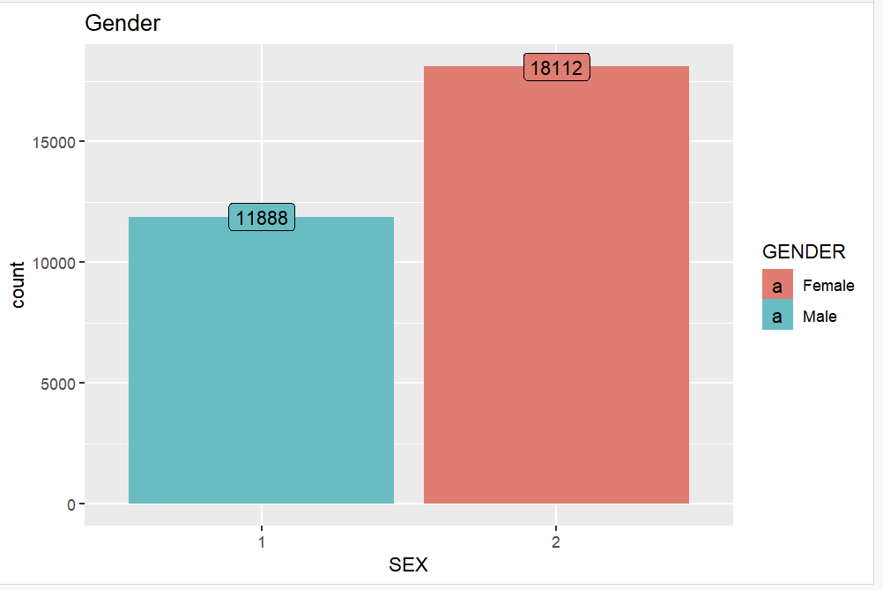
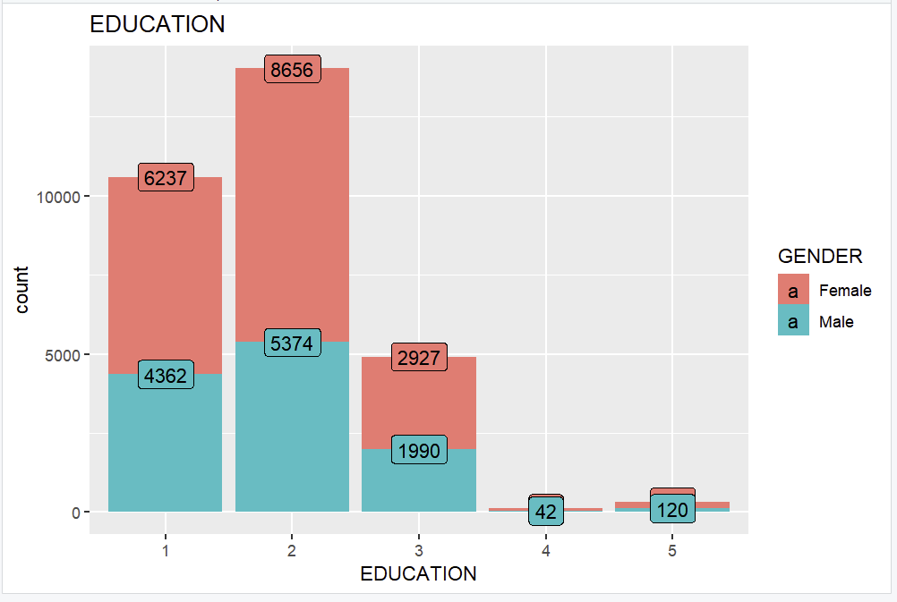
#Checking Defaulters by Gender to get a clear picture of our data.
#1
ggplot(data = df, mapping = aes(x = SEX, fill = DEFAULT)) +
geom_bar() +
ggtitle("Gender") +
stat_count(aes(label = ..count..), geom = "label")
#2
ggplot(data = df, mapping = aes(x = EDUCATION, fill = DEFAULT)) +
geom_bar() +
ggtitle("EDUCATION") +
stat_count(aes(label = ..count..), geom = "label")

Slide 6
#Splitting data into training and testing dataset.
set.seed(123) # for reproducibility
train_index <- createDataPartition(df$DEFAULT, p = 0.7, list = FALSE)
trainset <- df[train_index, ]testset <- df[-train_index, ]# Convert factor variables to dummy variables
trainset$SEX <- as.numeric(as.factor(trainset$SEX))
trainset$PAY_0 <- as.numeric(as.factor(trainset$PAY_0))# Similar conversions for the test testsettestset$SEX <- as.numeric(as.factor(testset$SEX))
testset$PAY_0 <- as.numeric(as.factor(testset$PAY_0))

Slide 7
In our dataset, we have use 4 types of models
1. Logistic Regression
the logistic model (or logit model) is a statistical model that models the probability of an event taking place by having the log-odds for the event be a linear combination of one or more independent variables. In regression analysis, logistic regression (or logit regression) is estimating the parameters of a logistic model (the coefficients in the linear combination).
2. Random Forest
Random forests or random decision forests are an ensemble learning method for classification, regression and other tasks that operate by constructing a multitude of decision trees at training time and outputting the class that is the mode of the classes (classification) or mean/average prediction (regression) of the individual trees.
3. Boosting Model
Boosting is an ensemble modeling technique that attempts to build a strong classifier from the number of weak classifiers. It is done by building a model by using weak models in series.
4. Neural Networks
A neural network is a network or circuit of biological neurons, or, in a modern sense, an artificial neural network, composed of artificial neurons or nodes. Thus, a neural network is either a biological neural network, made up of biological neurons, or an artificial neural network, used for solving artificial intelligence (AI) problems.

Slide 8
Model Building
Logistic Regression Model (LR)
#Fitting the training data to a logistic regression model
logit.reg <- glm(DEFAULT ~ ., data = trainset, family = "binomial")
summary(logit.reg)
# use predict() with type = "response" to compute predicted probabilities.
logit.reg.pred <- predict(logit.reg, testset, type = "response")
#Converting probabilities to 0 and 1 using 0.5 as threshold value.
logit.reg.pred.classes <- ifelse(logit.reg.pred > 0.5, 1, 0)
Random Forest Model
#Checking important variables
classifier.rf = randomForest(DEFAULT ~., data = trainset, ntree = 50)
varImpPlot(classifier.rf)
#Summary of RFM
summary(classifier.rf)
#Prediction using RFM.
our.predict.rf = predict(classifier.rf, newdata = testset, type = "response")

Slide 9
Boosting Model
library(adabag)
set.seed(1)
boost <- boosting(DEFAULT ~ ., data = trainset, mfinal = 20)
#Prediction using BM.
pred <- predict(boost, testset)
Neural Networks
nn <- neuralnet(DEFAULT ~ PAY_0 + SEX + BILL_AMT1 + PAY_AMT1 , data = trainset, linear.output = F, hidden = 2, learningrate = 0.05)
#plotting the neural network
plot(nn, rep="best")
#predicting default payments in validation dataset using above defined model
nn.pred <- predict(nn, testset, type = "response")
# cut off value of probability set to 0.5
nn.pred.classes <- ifelse(nn.pred > 0.5, 1, 0)

Slide 10
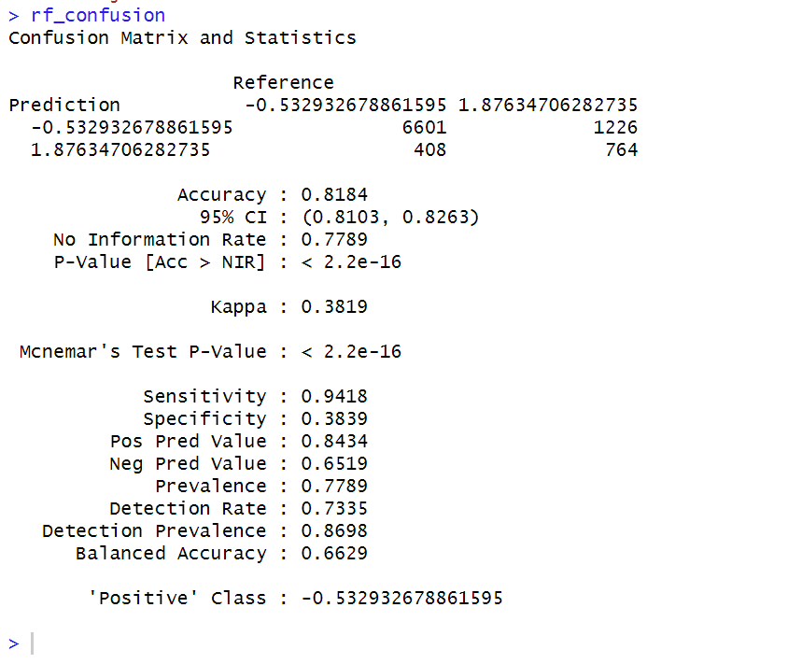
Model Evaluation
Logistic Regression Model
confusionMatrix(as.factor(logit.reg.pred.classes), as.factor(testset$DEFAULT))
Random Forest Model
rf_confusion <- confusionMatrix(as.factor(our.predict.rf), as.factor(testset$DEFAULT))

Slide 11
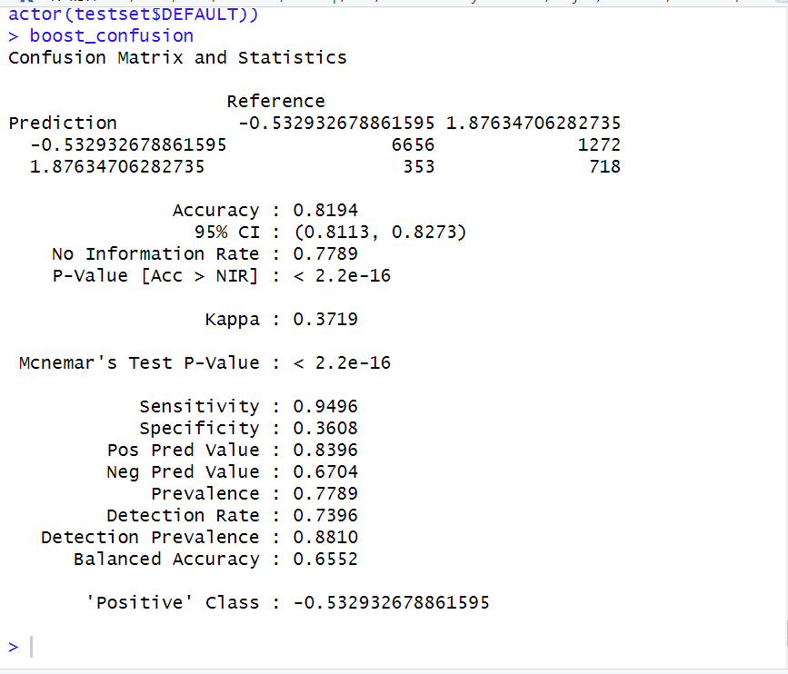
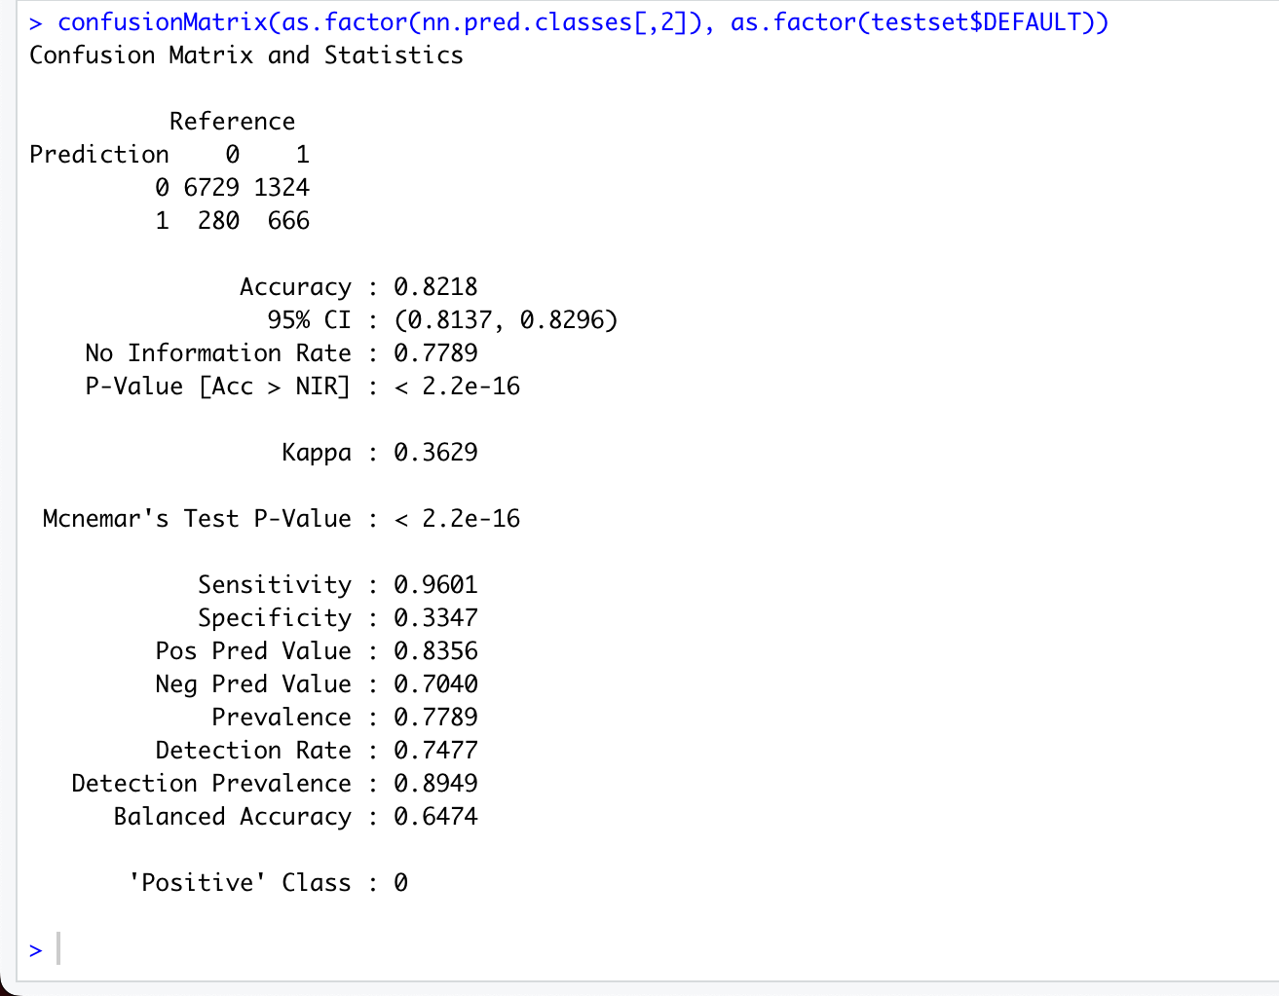
Boosting Model
Neural Networks
confusionMatrix(as.factor(nn.pred.classes[,2]), as.factor(testset$DEFAULT))
boost_confusion <- confusionMatrix(as.factor(pred.boost$class), as.factor(testset$DEFAULT))boost_confusion

Slide 12
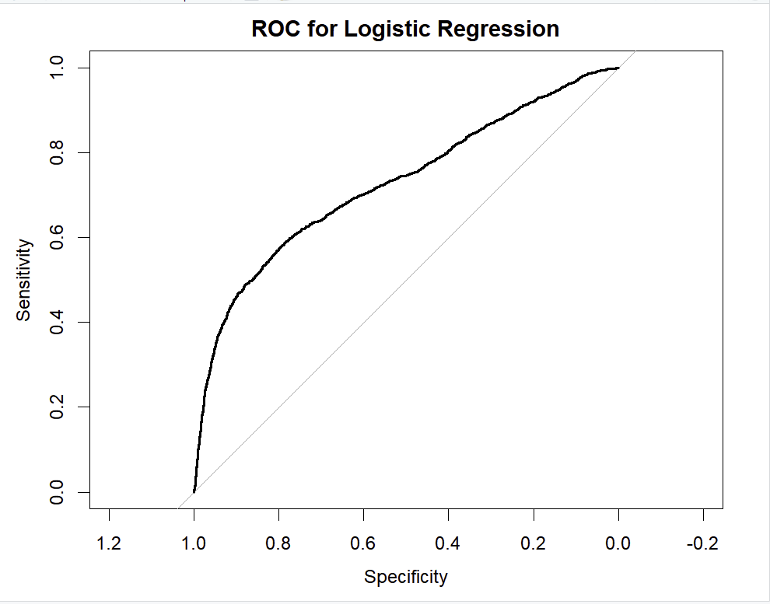
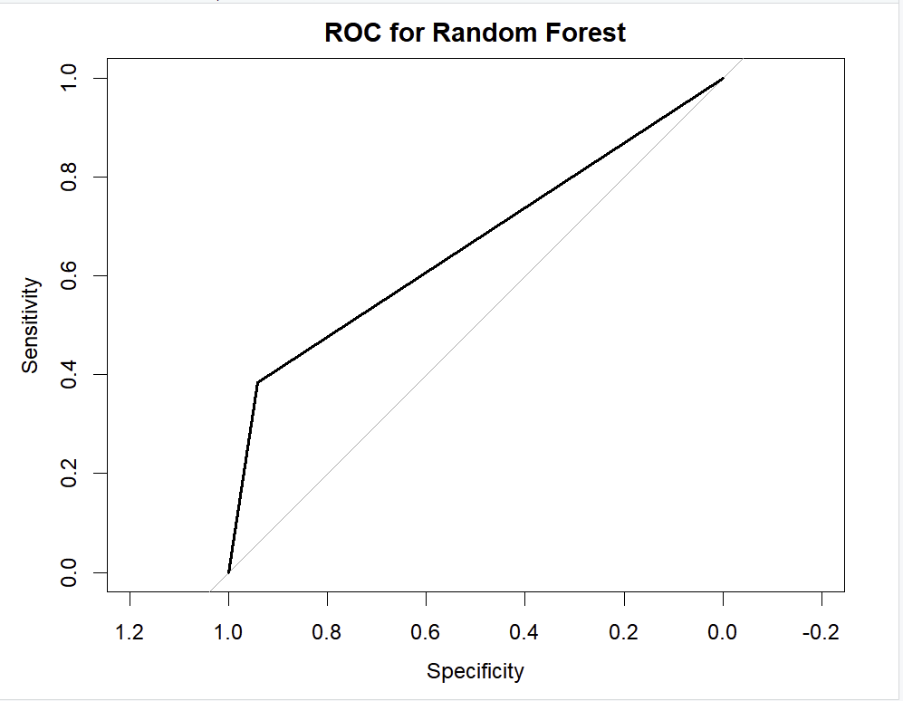
Area under the curve: 0.7267
#ROC Curve and Area under the curve(AUC)
Logistic Regression
logis <- glm(DEFAULT ~ ., data=trainset, family=binomial)
# ROC Curve for Logistic Regressionroc_lr <- roc(response = testset$DEFAULT, predictor = as.numeric(logit.reg.pred))plot(roc_lr, main="ROC for Logistic Regression")auc(roc_lr)
Random Forest
# ROC Curve for Random Forestroc_rf <- roc(response = testset$DEFAULT, predictor = as.numeric(our.predict.rf))plot(roc_rf, main="ROC for Random Forest")auc(roc_rf)
Area under the curve: 0.7267 - 72.6%
Area under the curve: 0.6629 - 66.29%

Slide 13
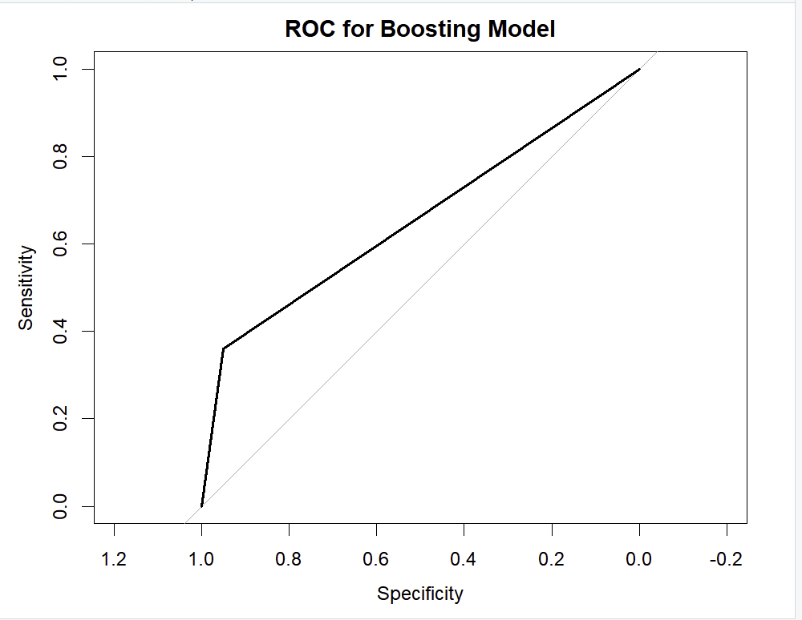
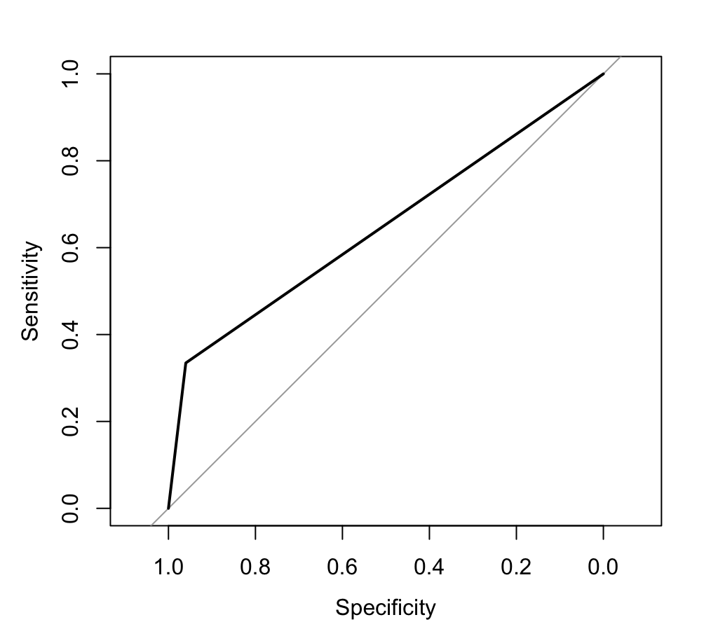
Boosting Model
roc_boost <- roc(response = testset$DEFAULT, predictor = as.numeric(pred.boost$class))plot(roc_boost, main="ROC for Boosting Model")auc(roc_boost)
Neural Networks:
roc_nn <- roc(response = testset$DEFAULT, predictor = as.numeric(nn.pred.classes))plot(roc_nn, main="ROC for Neural Network")auc(roc_nn)
Area under the curve: 0.6552- 65.52%
Area under the curve: 0.6474 64.74%

Slide 14
Findings and Conclusion
Our business goal is to identify people that will default their payment in future and avoid providing them credit cards.
Model | Accuracy | AUC
Logistic Regression | 82.2% | 72.6%
Random Forest | 81.84% | 66.29%
Boosting | 81.94% | 65.52%
Neural Network | 82.18% | 64.74%
After comparing accuracy score and AUC scores for these models we might come to conclusion that Logistic Regression is doing the best job for us. Though, that is not the case.
We want our model to classify people as precisely as possible. If our model classify a “Defaulter as Non-Defaulter” then this impact our business more gravely as compared to “Non-Defaulter as Defaulter”.
In other words, we want our “False positive rate” as minimum as possible.
So, comparing model using “False Positive Value”
Model | False Positives
Logistic Regression | 1286
Random Forest | 1226
Boosting | 1272
Neural Network | 1324
If we look at this way, Random Forest Classifier would be the one we would want to proceed further with. Also, in future our goal should be to focus on improving this value.

Slide 15
THANK YOU!
GROUP 2
Group Members:
Members:
Martin Aguirre
Vishruth Acharya
Yuvaraja Reddy Ambati
Varun Namala
Prasanth Chowdary Yanamandala

